Slide 1
A Guide to Preparing for Exams
The coming weeks and months are an important time for Year 11 students as you prepare for your examinations. This set of slides is aimed at helping all students to plan and use their revision time effectively, as well as giving parents/carers some tips on how you can help and support your child at home.

Slide 2
A Guide to Preparing for Exams
Contents:
1. Dual Coding
2. Mind-maps
3. Flash-cards
4. Using video
5. Using past papers
6. Making a revision timetable

Slide 3
Revision Skills
The revision techniques and examples that follow form part of the Year 11 tutor time revision programme that all students have worked through since returning in September.
Every student will find the techniques they feel suit their own style of learning. There is not one fixed way to revise.

Slide 4
Revision Technique 1: Dual coding
Cognitive scientists have found that connecting pictures and words can help you remember information more effectively than just using one or the other. This is called dual coding.

Slide 5
Ready to Revise: How can I use dual coding to improve my recall and retention of information?
Example 1: The skull is made up of a number of different areas that include the parietal (the top of the head), occipital (at the base of the skull near the neck), the frontal (near the forehead), and the temporal (near the temples). The facial bones are part of the skull. The mandible is known more commonly as the jaw with the maxilla being the upper jaw. The eye sockets are called the lacrimal.
Example 2
Which example would help you learn the parts of the skull most effectively? Why?

Slide 6
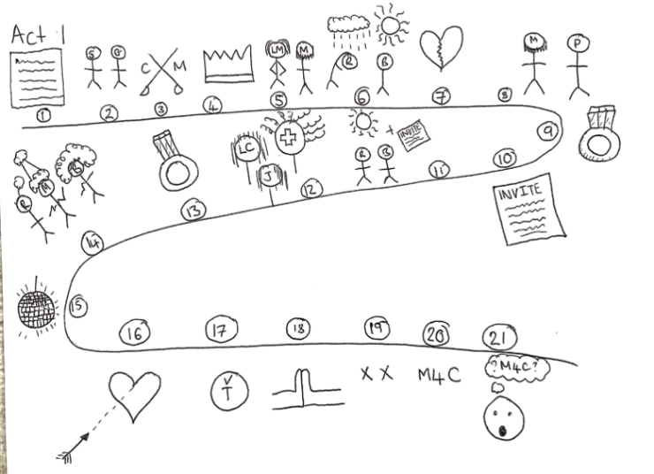
Ready to Revise: How can I use dual coding to improve my recall and retention of information?
Notes:
This is a visual representation of the plot of Shakespeare’s ‘Romeo and Juliet’.

Slide 7
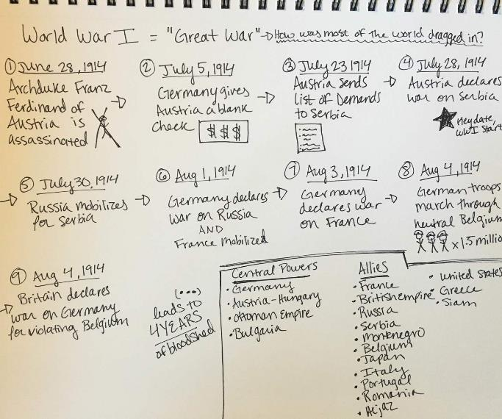
How can I use dual coding to improve my recall and retention of information?
How about this one for World War 1?
On a sheet of paper create your own dual coding guide to
Act 1 of ‘An Inspector Calls’.
Add quotes if you can
Notes:
This is a visual representation of the plot of Dickens’ ‘A Christmas Carol’.

Slide 8
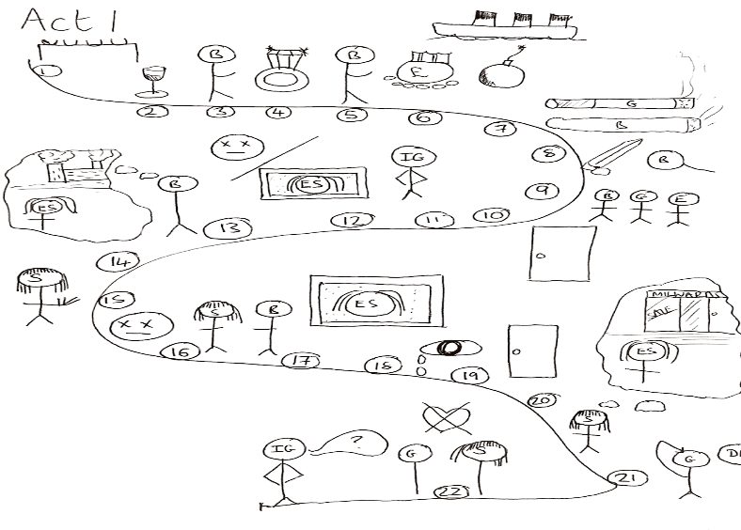
How can I use dual coding to improve my recall and retention of information?
Act 1 of ‘An Inspector Calls’.
Notes:
This is a visual representation of the plot of Dickens’ ‘A Christmas Carol’.

Slide 9
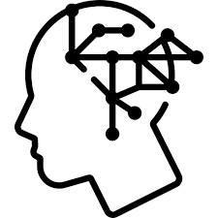
Revision Technique 2: Mind-map
A mind map is a visual diagram that provides an overview or summary of a topic or idea.
Creating mind maps is a technique that many students find effective when revising.

Slide 10
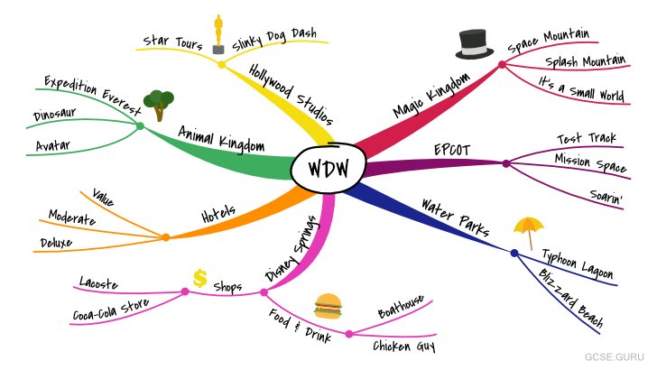
The main subject, topic or idea is located in the centre, with related ideas and information branching from it in many directions.
Each related idea may have further information or ideas branching from them.
Both words and images can be used when creating a mind map.

Slide 11
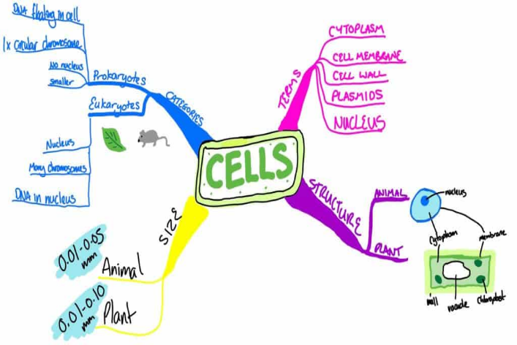
Mind maps allow you to see everything at a glance
Mind maps are concise and constrained to a single side of paper.
This allows you to see all the information for that topic at a single glance, all in one place.
Seeing the information in this format also helps you to quickly and easily spot connections and relationships.

Slide 12
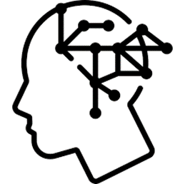
How to create a mind map
Put your main idea or topic in the middle of page and draw a circle around it. This will be your starting point
Add related keywords or phrases all around this, then use lines to connect these ‘first level branches’ to the starting point
As needed, connect further keywords and phrases to the first level branches (these are called child branches)
If needed, add further branches to your child branches

Slide 13
Remember:
Use keywords and short phrases, not full sentences
Use images, icons and colour as you see fit. These are really helpful memory triggers
Try to create a sense of hierarchy as you break down the information
Keep the mind map to one side of paper
Don’t worry about your artistic skills, it’s not a competition

Slide 14
On the following slides are examples from different subjects

Slide 15
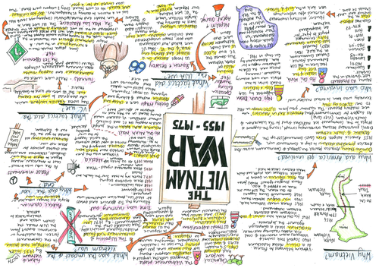
History

Slide 16
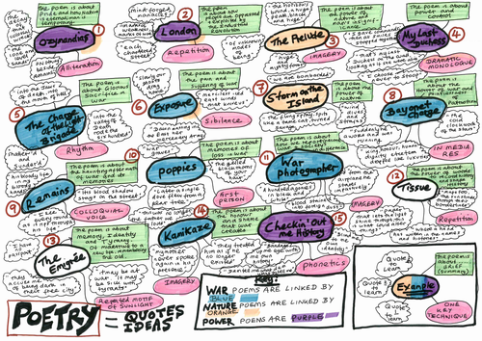
English Lit Poetry

Slide 17
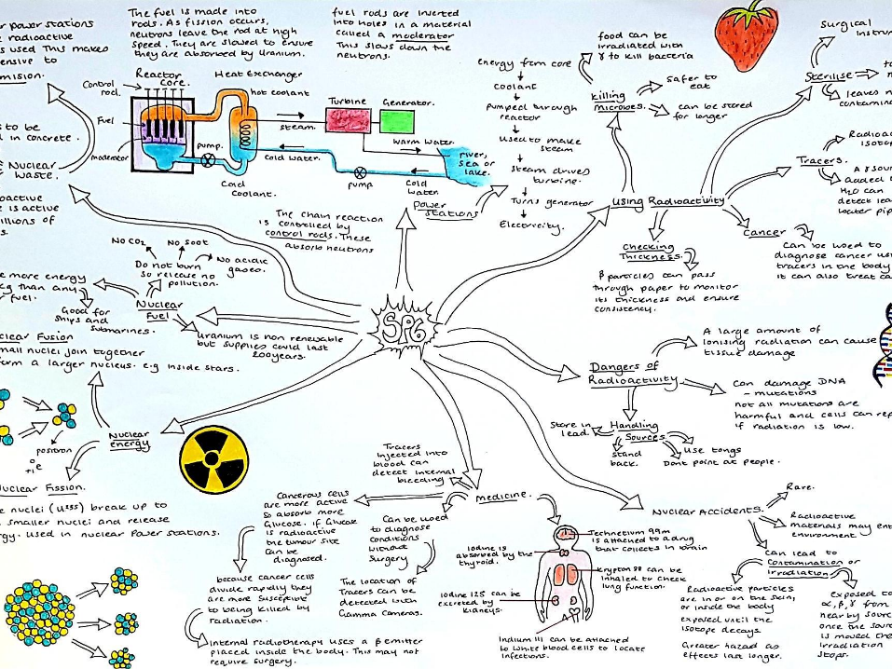
Physics

Slide 18
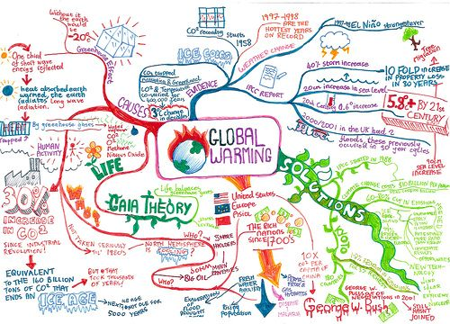
Geography

Slide 19
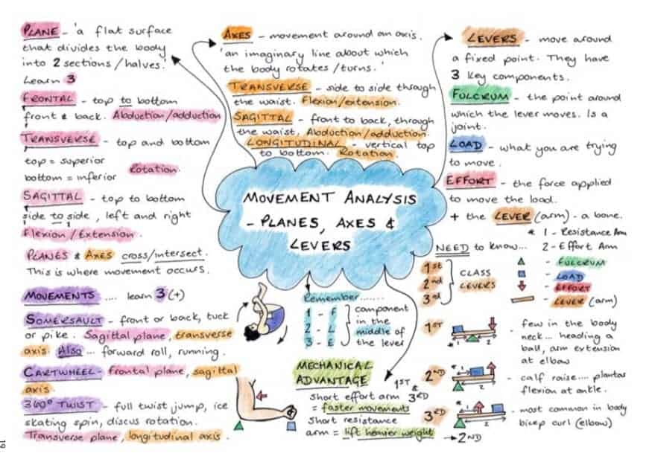
PE

Slide 20
Revision Technique 3: Flash cards
One of the best and most widely-used methods of using flashcards is known as the Leitner system. This system involves grouping your flashcards according to how well you remember the contents of each card. Essentially, it helps you spend more time studying the cards you are the least familiar with.

Slide 21
Flash cards
There is always a relationship between the information on both sides of the card, e.g. key term and definition, question and answer etc.
Because you can only see one side of the card at a time, you can use flash cards to test your knowledge, by instantly checking your guess.
Flash cards are an effective tool for revising keywords, vocabulary, and other subject specific information.

Slide 22
How to create your own set of flash cards
A flashcard is basically an opportunity to condense, simplify or summarise a topic. Of course, you can still use mind maps or flow charts etc for more complicated topics.
The main thing is to move away from pages and pages of dense information to help separate it all out.

Slide 23
Just How Useful are Flashcards?
Chunking down firstly makes it easier to remember key information. Secondly, it can kickstart revision when you’re stuck.
Flashcards are a great way to test yourself
Use them to spot gaps in your knowledge
They are ideal for learning dates, language vocabulary, formulae, definitions
Because they are small, they’re transportable. Flick through them on the bus home, take them to a mates if having a study sesh, go through subject ones before a test to jog your memory

Slide 24
How to use your flash cards properly
Flash cards are used to test your knowledge, a quick way to check what you know.
Read the question or key term from the front of the card
Try to remember the definition or answer without looking
Check your guess by looking at the back of the card
As you work through your flash cards, it is a good idea to separate them into different piles:
I know this
Not sure about this
I don’t know this at all

Slide 25
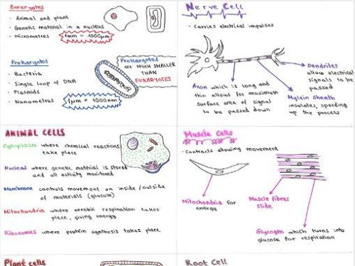
Biology

Slide 26
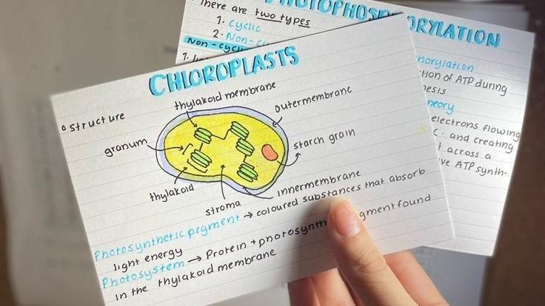
Biology

Slide 27
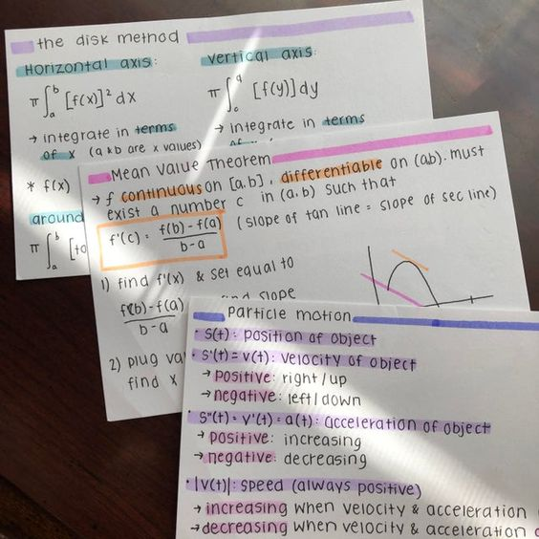
Maths

Slide 28
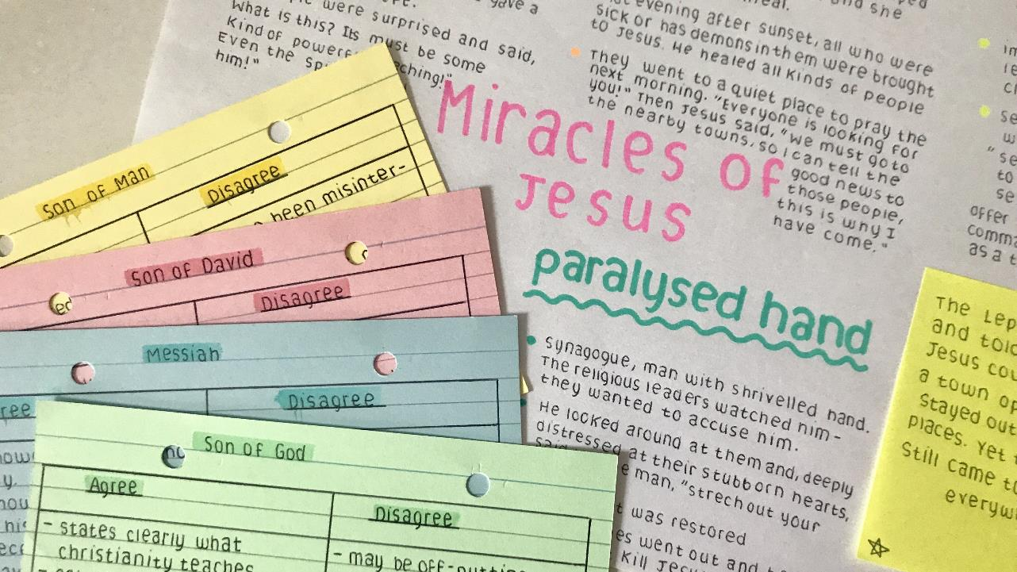
RE

Slide 29
Geography

Slide 30
PE

Slide 31
Eng Lit

Slide 32
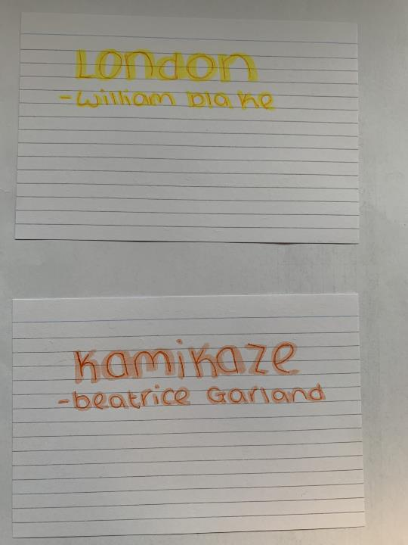
Eng Lit

Slide 33
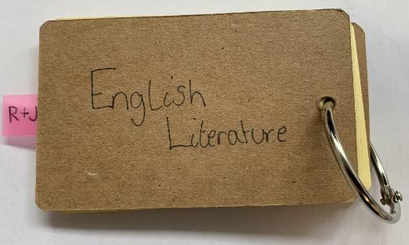
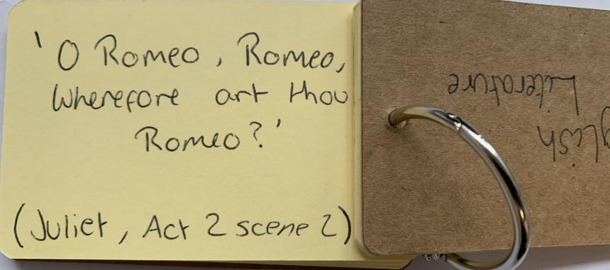
Eng Lit

Slide 34
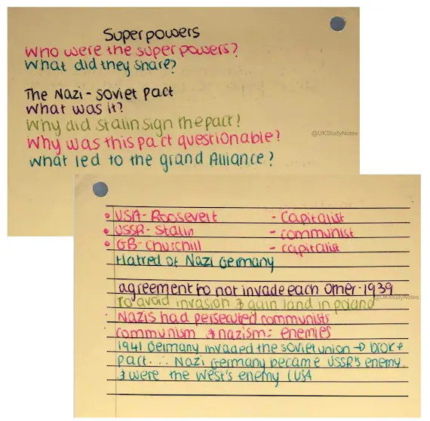
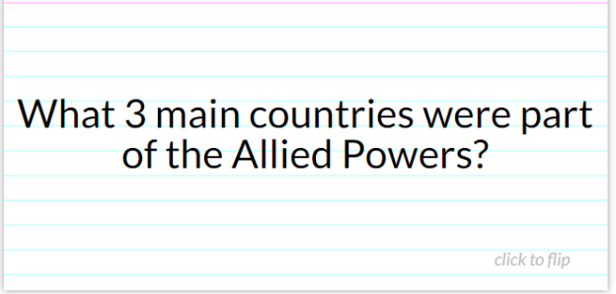
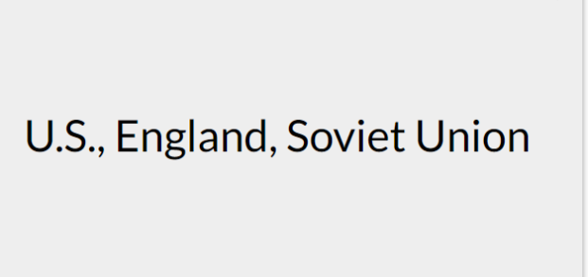
History
Side 1
Side 2

Slide 35
Revision Technique 3: Flash cards
The Leitner Technique
One of the best and most widely-used methods of using flashcards is known as the Leitner system. This system involves grouping your flashcards according to how well you remember the contents of each card. Essentially, it helps you spend more time studying the cards you are the least familiar with.

Slide 36
Ready to Revise: How can I use flashcards and self-quizzing effectively?
Click image below to watch the clip
This system ensures you review the flashcards on information you don’t know yet, most often.
Notes:
https://www.youtube.com/watch?v=C20EvKtdJwQ (clip is 2:50 mins long)

Slide 38
Revision Technique 3: Using videos
Wouldn’t it be great if you could just sit in front of some videos for a few hours and all the maths knowledge you need to pass your GCSE would just download into your brain and stay there?
Unfortunately, our brains don’t work like that, learning is hard work and takes effort.

Slide 39
In order to make the time you spend revising worthwhile and effective, follow these steps when you use a video to revise.
Give your full attention to the video. You remember what you pay attention, so concentrate on the video and don’t do other things (like messaging etc) at the same time.
Watch and re-watch the video or parts of it as many times as you need to. Unlike your teacher, a video can be rewound and paused. Take your time and make sure you understand each part before moving on.
If using a phone to view video, mute notifications and messages.

Slide 40
3. Pause the video regularly to:
Take notes of examples and any important information. Writing things down will help you remember them better.
Complete questions or examples before watching the solutions.
Resist watching solutions as soon as questions become difficult.
4. After you have watched the video find some questions on the same topic or skill to practice and check your understanding.
5. Go back to the topic a few days later to practice some more questions. Watch the video again if you need to.
If using a phone to view video, mute notifications and messages.

Slide 41
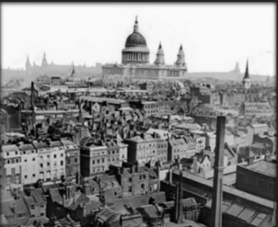
Use a ‘thinking hard’ strategy – ‘Boxing up’
Divide a page into 3 sections and use the headings below.
Watch a revision clip, GSCEpod, Bitesize, Mr Bruff etc…divide longer clips into 5 min chunks. Pause and try to add at least 1 idea to each box every 5 mins. Try it out with this clip on context in Jekyll and Hyde. (click on image to play)
Box 1 – three things I did not know.
Box 2 – three things I understand better now.
Box 3 – three things I already knew.

Slide 42
Don’t forget about gcsepod! All your subjects with bitesize videos, quizzes and questions

Slide 43
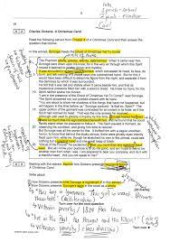
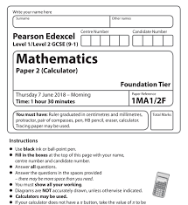
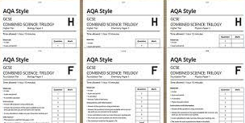
Revision Strategy 5 :Past paper questions.
You should begin trying past paper questions as far in advance of your exam as possible.
Ask your subject teacher the exact name of the exam board and specification.
Exam board websites have lots of past papers on their websites.
Ask your teacher for extra examples

Slide 44
Revision Strategy 5 :Past paper questions.
Checking on your progress isn’t just about using past papers.
Check out command words carefully to understand what the question is asking of you!
Use past papers to make sure that you are managing your time well. Set yourself a time frame to complete each question
Go through past paper answers with a different colour pen to highlight any marks you lose or mistakes you make
Test yourself. Find out if your revision has been effective by using past papers or ask someone to test you
If your notes are all bullet points, past papers might be the first chance you have to write in clear and linked sentences!
Examiner reports can give you an idea of where students went wrong in previous exams
Repeat your testing – it is important you test yourself more than once. Try it ten minutes after revising a topic, one day after, then a week later.

Slide 45
Revision Skills
How to create a revision timetable

Slide 46
How to create a revision timetable
All students have been given
a personalised mock timetable
Blank revision timetables
A revision booklet with all topics for mocks and for summer exams

Slide 47
Mock timetable
WEEK 1
Monday 4th December | AM | English Language (105 mins)
 | PM | Maths Paper 1 (90 mins)
Tuesday 5th December | AM | English Literature (105 mins)
 | PM | Combined Science - Biology (75 mins)
 |  | Triple Science - Biology (105 mins)
Wednesday 6th December | AM | Maths Paper 2 (90 mins)
 | PM | Combined Science - Chemistry (75 mins)
 |  | Triple Science- Chemistry (105 mins)
Thursday 7th December | AM | Maths Paper 3 (90 mins)
 | PM | Combined Science - Physics (75 mins)
 |  | Triple Science - Physics (105 mins)
Friday 8th December | AM | History Paper 1 (120 mins)
 | PM | Geography Paper 1 (90 mins)
WEEK 2
Monday 11th December | AM | French Listening & Reading (80/105 mins)
 | PM | Business paper 1- (90 mins)
Tuesday 12th December | AM | PE papers 1&2 - (120 mins)
 |  | RE paper 1&2 (105 mins)
 |  | Music - (90 mins) (CD)
 | PM | French Writing (60/75 mins)
Wednesday 13th December | AM | Design & Technology (120 mins)
 |  | Engineering (75 mins)
 | PM | Geography Paper 2 (75 mins)
Thursday 14th December | AM | Computer Science Paper 2 (120 mins) ONLINE
 |  | Food & Nutrition (105 mins)
 | PM | History Paper 2 (60 mins)
Friday 15th December | AM | Computer Science Paper 1 (90 mins)
This is where you should begin with planning a revision timetable

Slide 48
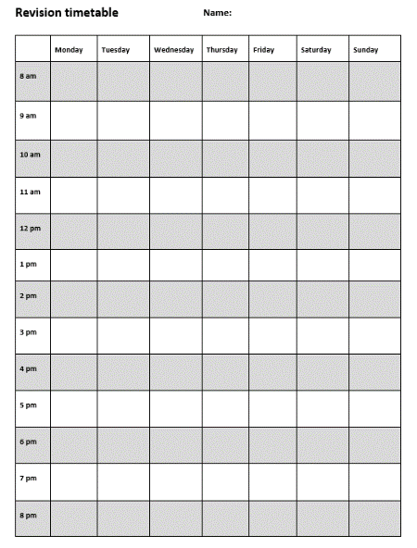
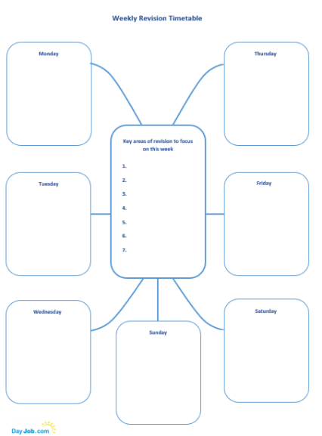
All students have been given multiple copies of these timetables…they should choose which they prefer…or even make their own.

Slide 49
First task…
List all the subjects that you need to do revision for.
Now rank them in order, with the first being the subject in which you need to do the most revision.
Discuss this with teachers if you need to.
See example on next slide.

Slide 50
An example:
Subjects to revise for:
Maths
English
Science
Geography
RE
Music
Business Studies
Rank order (most revision needed)
1st. Science
2nd. Maths
3rd. Geography
4th. English
5th. Business Studies
6th. Music
7th. RE

Slide 51
So, what’s your next step?
Look at your mock timetable.
Plan the subjects you feel you need to revise most in order of where they come in the 2-week mock timetable.
All core subjects are in first week, mix those with the first ones that come in week 2
Don’t start with only subjects that are in week 2
1st. Science
2nd. Maths
3rd. Business
4th. English
5th. Geography
6th. Music
7th. RE

Slide 52
Now it’s time for you to think about planning your own timetable using the Pomodoro Technique
Choose a time when you are well-rested and used to working.
Decide the specific task you are going to complete (e.g. I will complete a Science revision module about electrolysis of aqueous substances).
Set up your study area.
Decide on how many 25-minute slots you will need to complete the task you have decided to complete.
Set a timer for 25 minutes. Ideally use a digital timer which is not on your phone.
Spend the entire 25 minutes working. If you have spare time at the end, start another task.
When the timer goes off, leave your working area and take a 5-minute break.
Repeat. Take a longer break after every 3x25-minute sessions.

